Slide 1


IOT Wind Turbine Insights and Intelligence using GGSA
- Keep It Running
Rohit Lingala | Project Intern
Oracle Energy and Water | Integrations
Notes:
notes

Slide 2
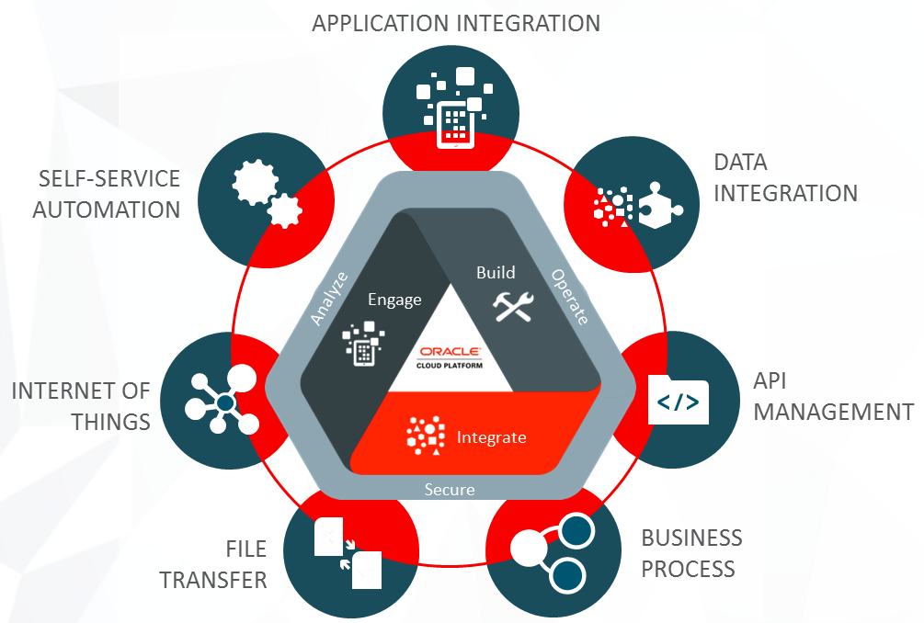
About Integrations
Oracle Integration is an enterprise connectivity and automation platform for quickly modernizing applications, business processes, APIs, and data.
Developers and cloud architects can connect SaaS and on-premises applications six times faster with a visual development experience, prebuilt integrations, and embedded best practices

Slide 3
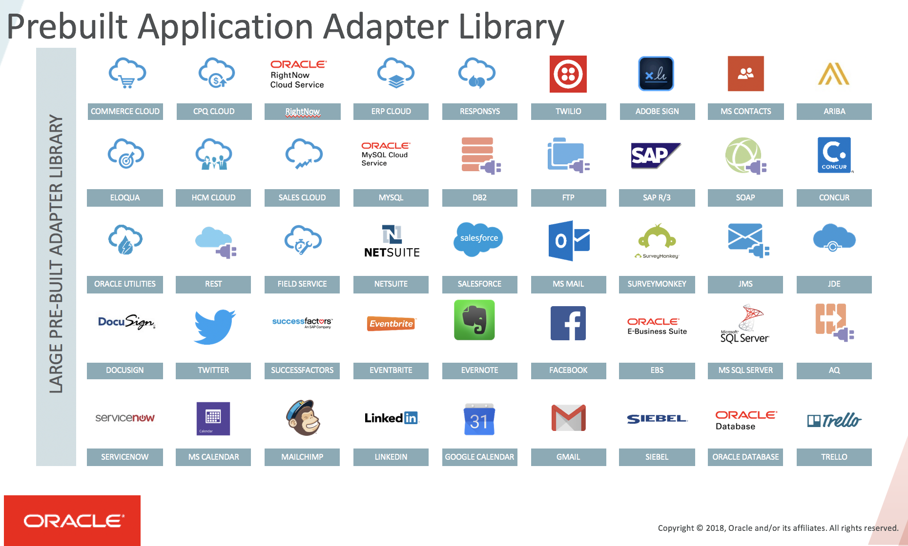
OIC

Slide 4
Contents
AIM
Methodology
Market/domain and the potential opportunity
High level view
Overview of the tools used
Low level view
Procedure
Future scope
Summary

Slide 5



AIM
Finding a better solution/design to maintain assets (Wind Turbine)
Notes:
Our sol helps us in – based on the deviations in the data. – condition monitoring system
Some benefits include:
Reducing machine failures, which saves lot of money
Extend asset life
Increase the rate of production
Cut maintenance costs
Prioritising Maintenance Tasks
With frequent and reliable updates about your machinery, you have a real-time list of potential maintenance tasks and their priority.

Slide 6
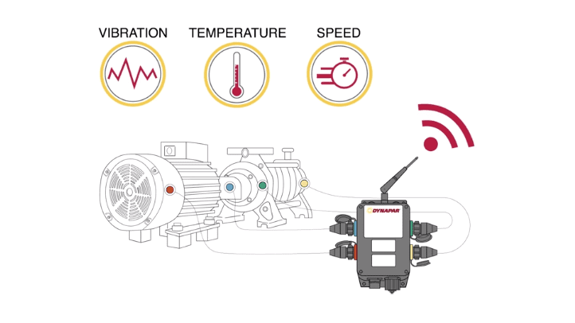
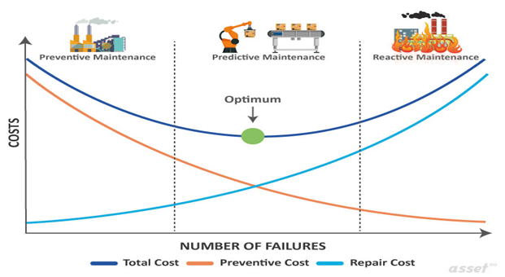
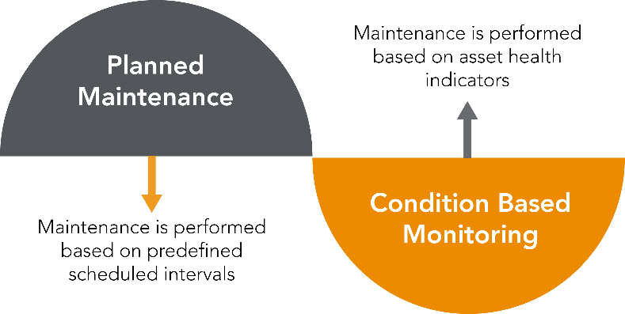
Methodology
Condition Monitoring
Notes:
It revolves around the principle of predictive maintenance, which is a proactive way of fixing malfunctioning equipment before they cause problems
We all know that Faults always develop in machinery and even the most comprehensive routine maintenance programme cannot stop that. Therefore, it’s important to have condition monitoring
actively prevent breakdowns and optimize maintenance resources when and where they are needed.
not only recognized developing faults within a machine but also to identify factors within a machine that caused these faults to develop

Slide 7
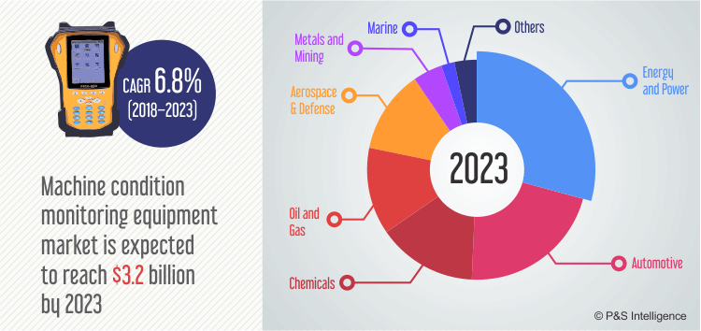
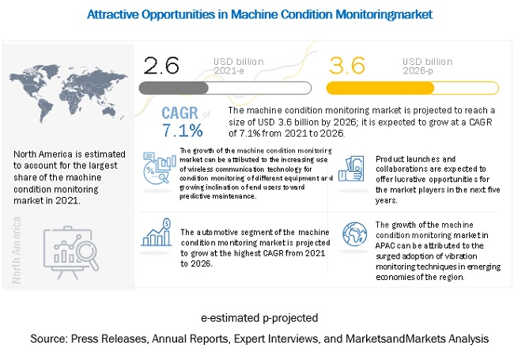
Market/domain and the potential opportunity
7
Potential Opportunities :
Lowering Maintenance Costs
Maximizing Production Output
Extend asset Life
Reducing machine failures (Catch Small Variations Early)
Understand Your Specific Equipment
Create Intelligent Analysis Over Time
Automated workflow
Immediate response to events.
Schedule Maintenance As Needed
Notes:
With the evolution of IIOT, CM market is expected to reach 3.2B by 2023 and 3.6 billion by 2026 with compound annual growth rate of 7.1% from 2021 -2026
These are some of the advantages of using condition monitoring
It can reduce maintenance costs by up to 25%, cut unplanned outages by up to 50%, and extend the lives of machines by few years.
Close observation and data analysis of the assets helps plant engineers get to know the unique quirks of each asset
Maintenance activities based on asset condition, rather than on a pre-set interval, has the potential to progress maintenance activities to a new level of efficiency

Slide 8
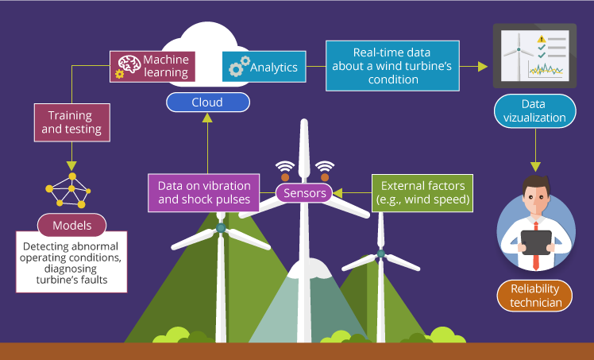
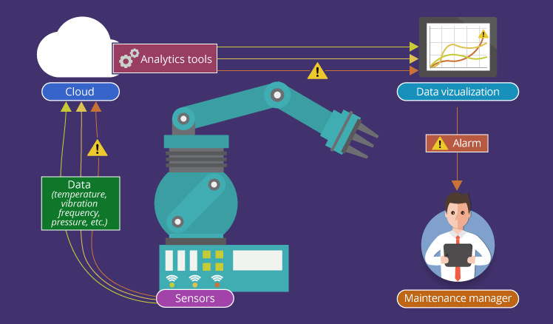
Model
High Level view

Slide 9

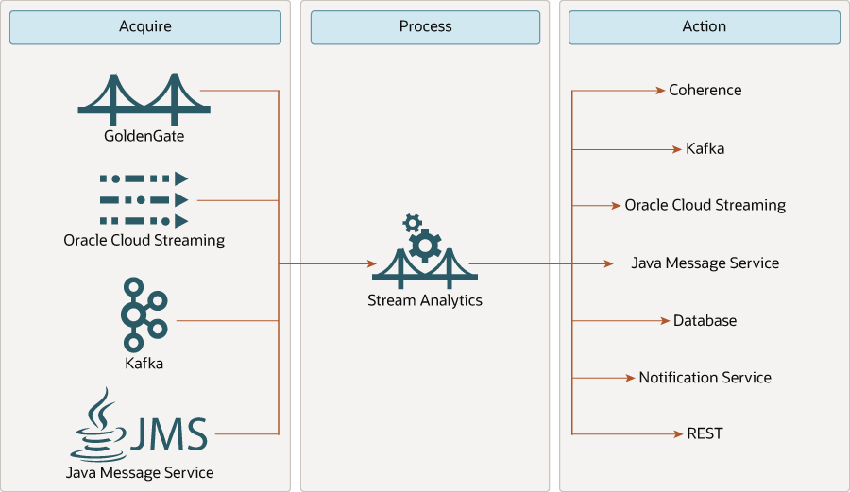
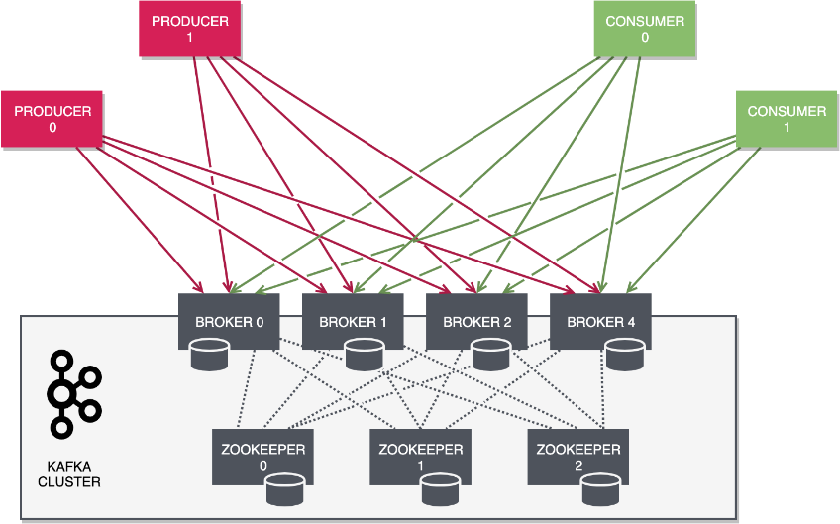
Overview of the tools used
Tools Used:
Oracle IoT Digital Twin Simulator
Kafka
Oracle GoldenGate Stream Analytics (GGSA)
Oracle Integration Cloud (OIC)
Oracle Autonomous Database
Oracle Work and Asset Management
REST APIs
Python
Notes:
GGSA enables Fast Data and Internet of Things (IOT) – delivering actionable insight and maximizing value on large volumes of high velocity data from varied data sources in real-time. It enables distributed intelligence and low latency responsiveness by pushing business logic to the network edge.
Oracle Integration Cloud is an industry recognized leader in Application Integration and Process Automation. Quickly connect to 1000s of SaaS or on-premises Applications seamlessly through 50+ native app adapters or technology adapters.

Slide 10
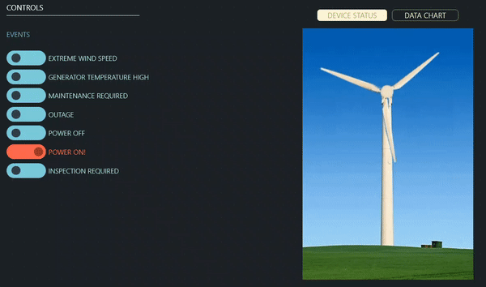

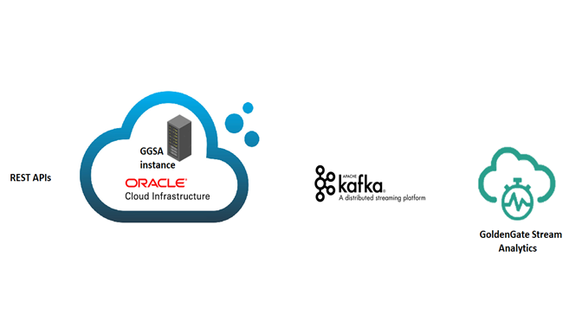








Low Level View
OIC
Oracle autonomous database
OFSC
WAM
State restored
Worker assigned

Slide 11
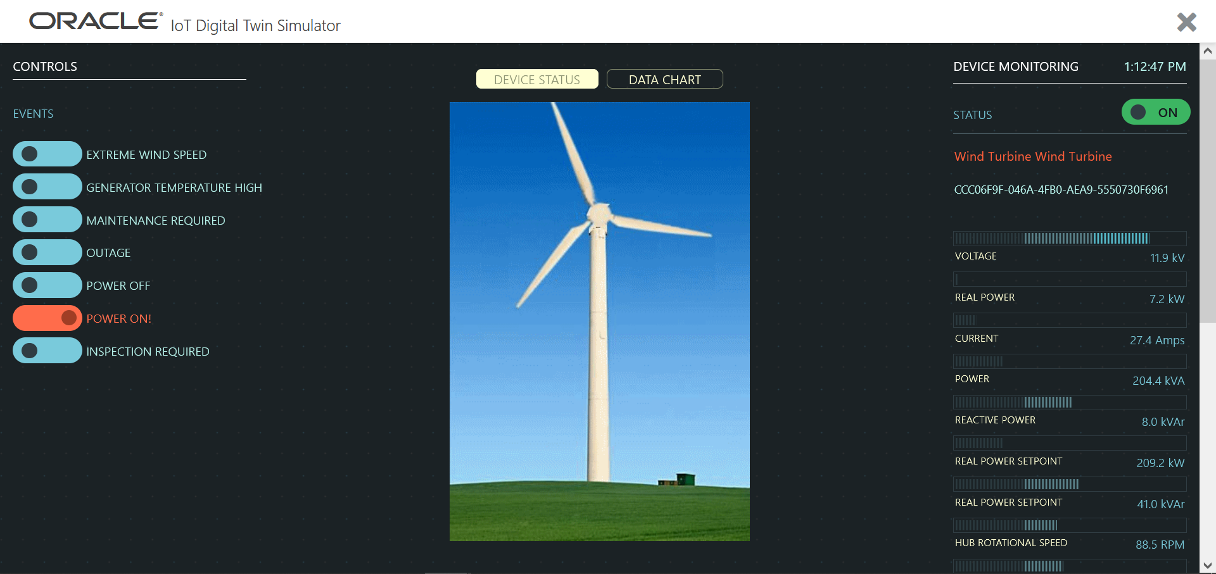

Slide 12
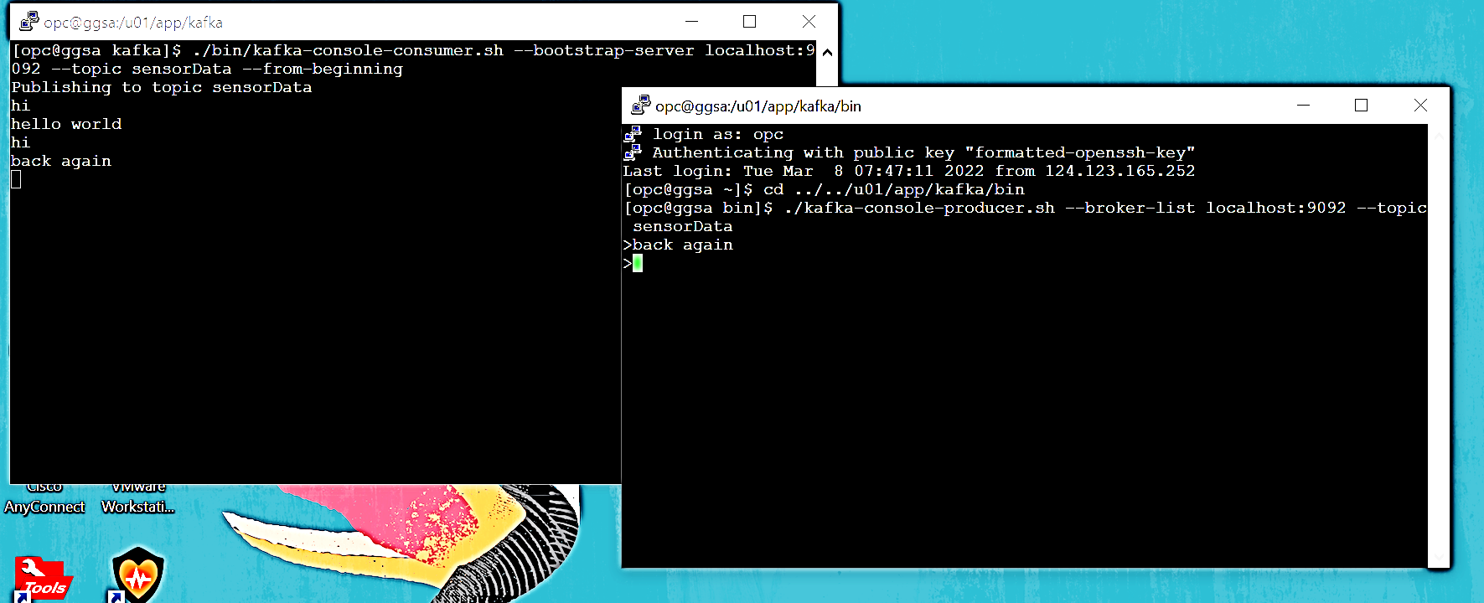
Step 0: Created a topic in Kafka to stream the data and tested
Notes:
Kafka comes by default in GGSA
Tested kafka by topic sensorData, 2 sessions to GGSA

Slide 13
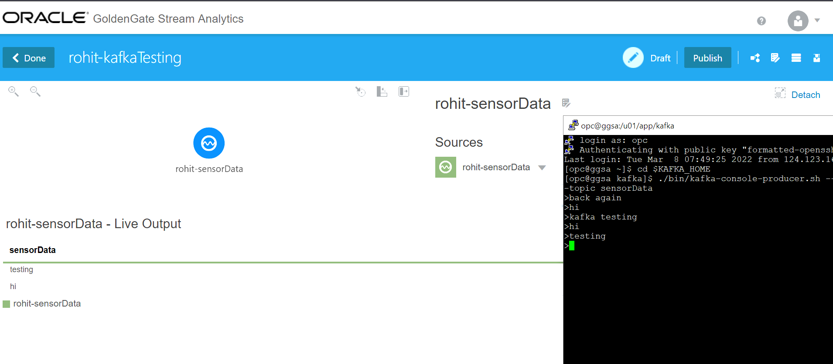
Step 1: Consuming the data published to topic from GGSA

Slide 14
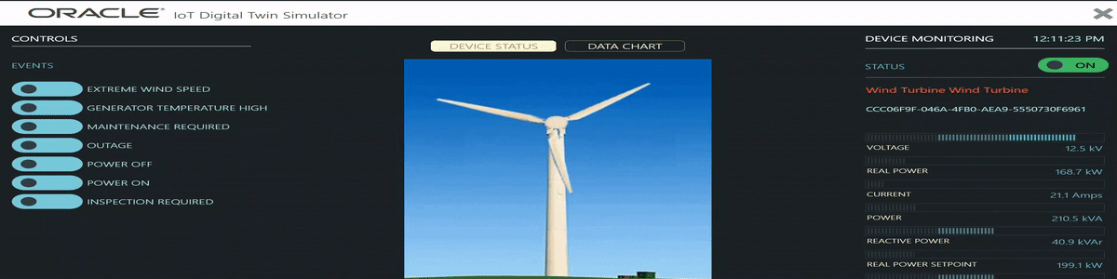
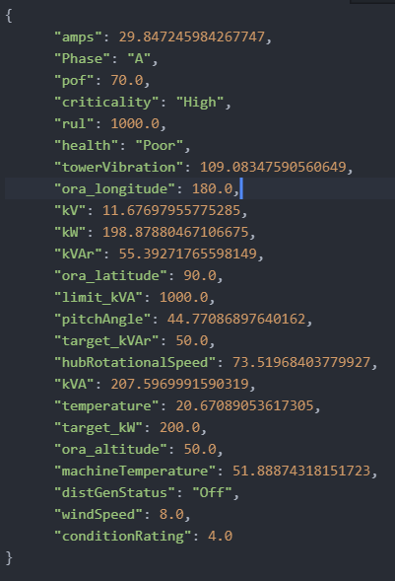
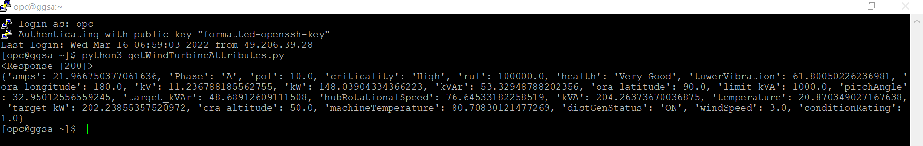
Step 2: Fetching attributes of wind Turbine to GGSA instance.
10
3) Pushing this file to Kafka
1) Fetch Senor attributes using REST APIs to Cloud
2) Response saved to a .json file

Slide 15


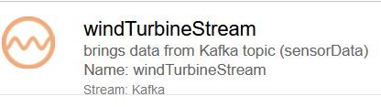
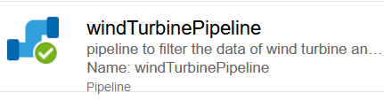

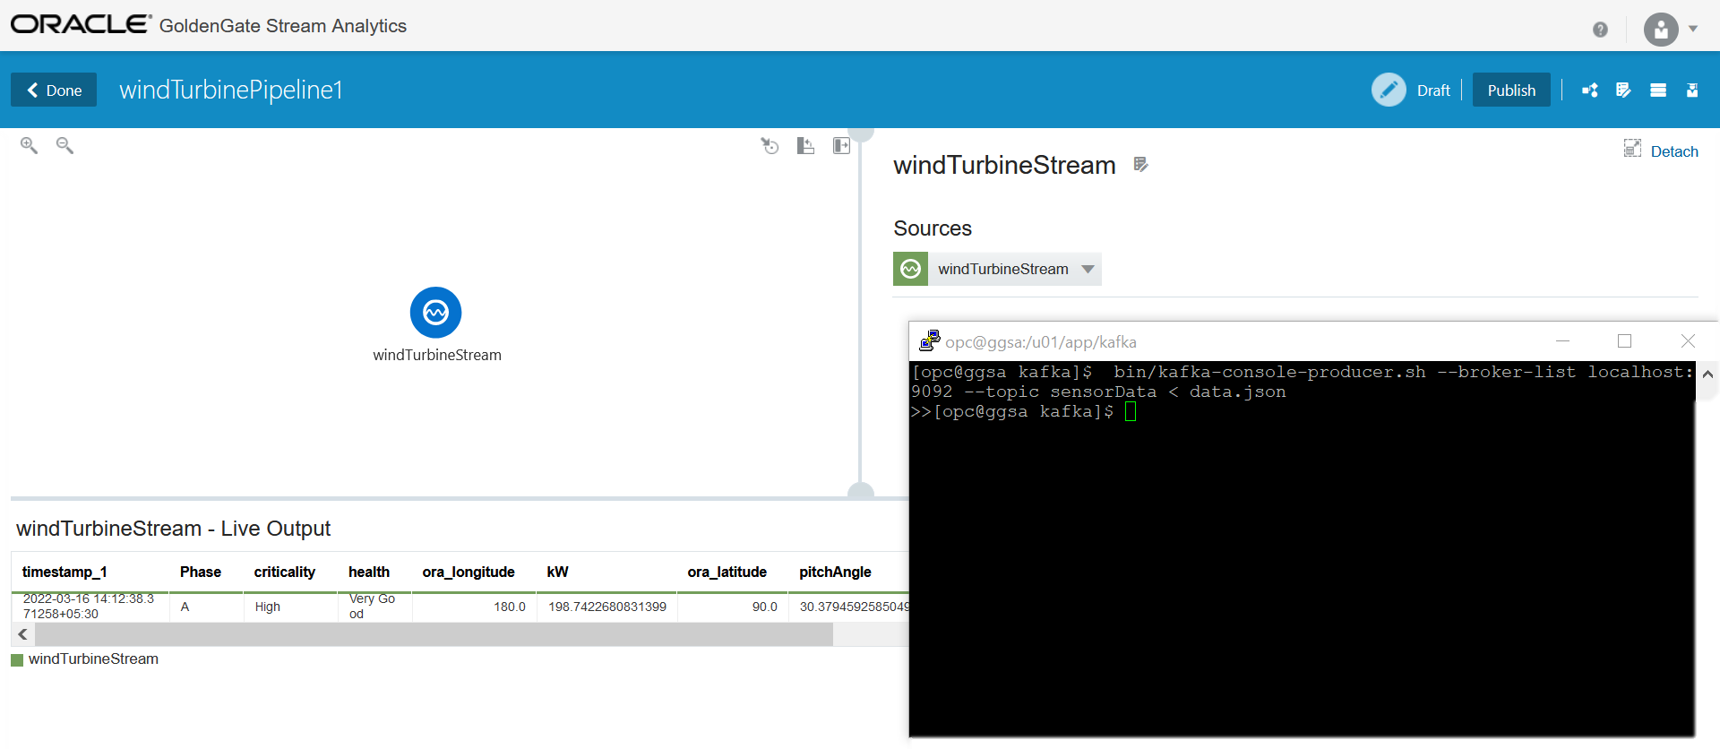
Step 3: Publishing the fetched sensor data to Kafka topic and consuming it from GGSA
Notes:
Autonomous db populate automatically – filtered data

Slide 16
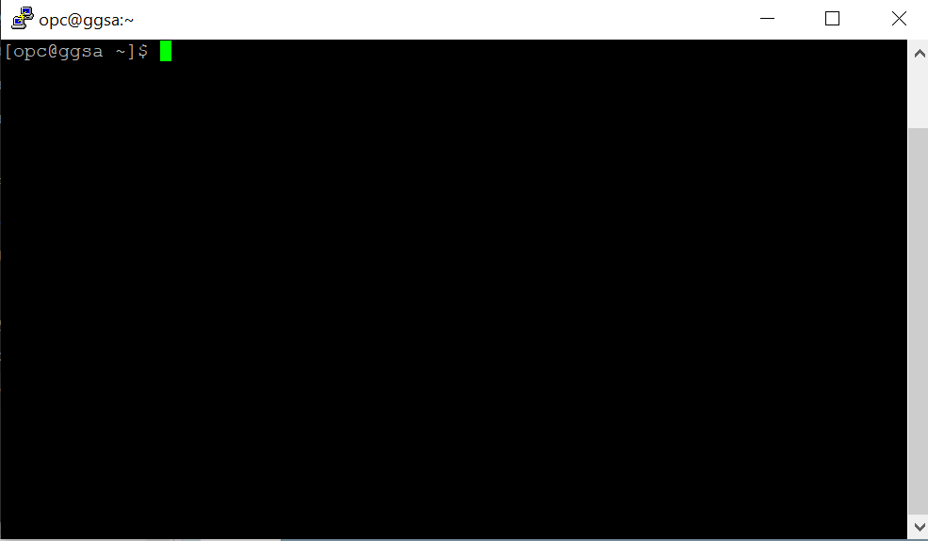
Step 4: Looping step 2,3 using bash script for every 1 min as a child process and detaching it from the terminal
while true
do
python3 getWindTurbineAttributes.py
bin/kafka-console-producer.sh --broker-list localhost:9092 --topic sensorData < data.json
sleep 60
done

Slide 17
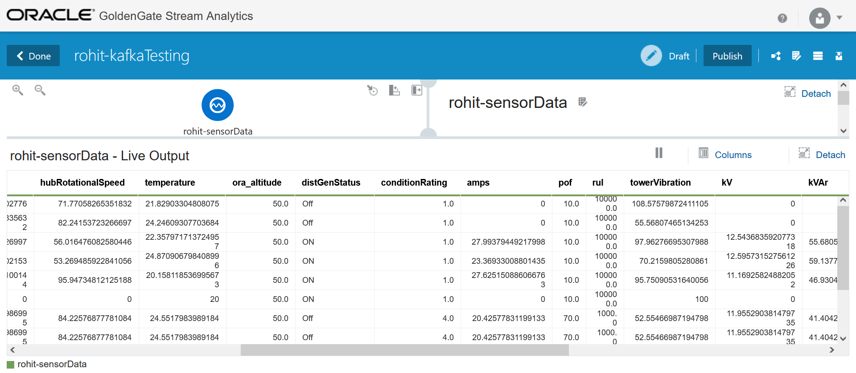
Output: Populated sensor Data in GGSA

Slide 18
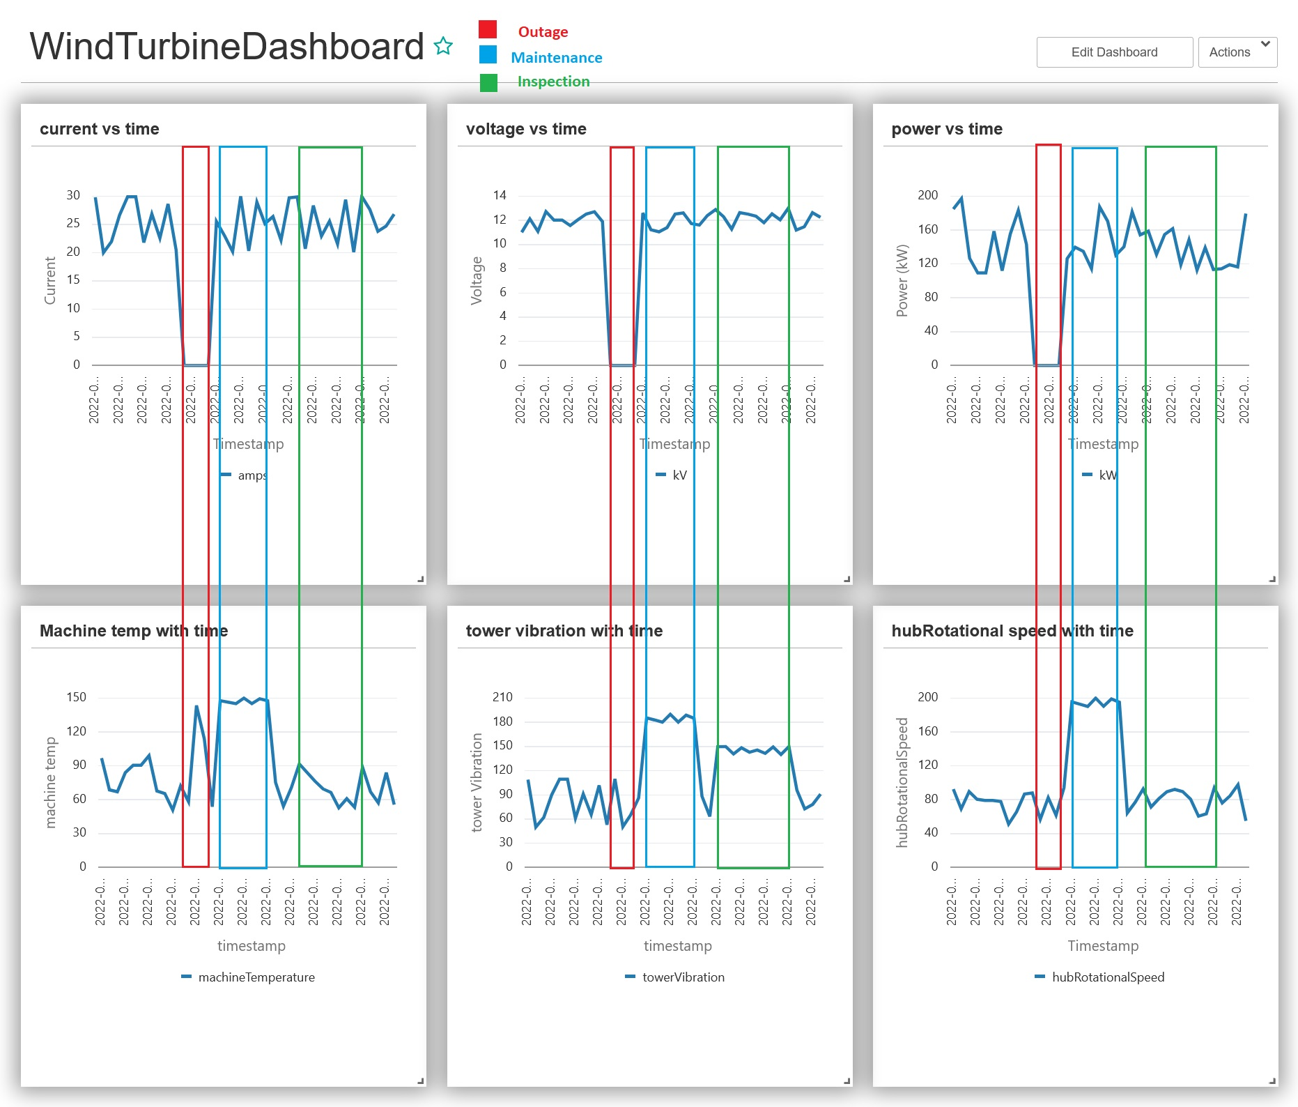
Step 5: Identifying the patterns in the data for the events

Slide 19
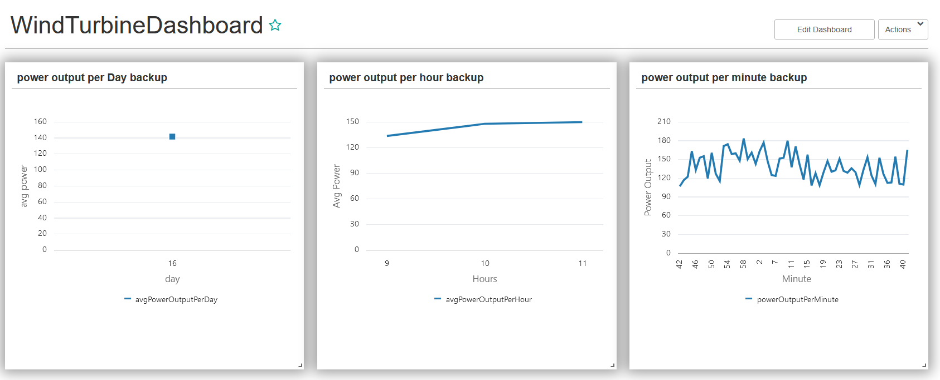
Step 6: Visualizing the data

Slide 20
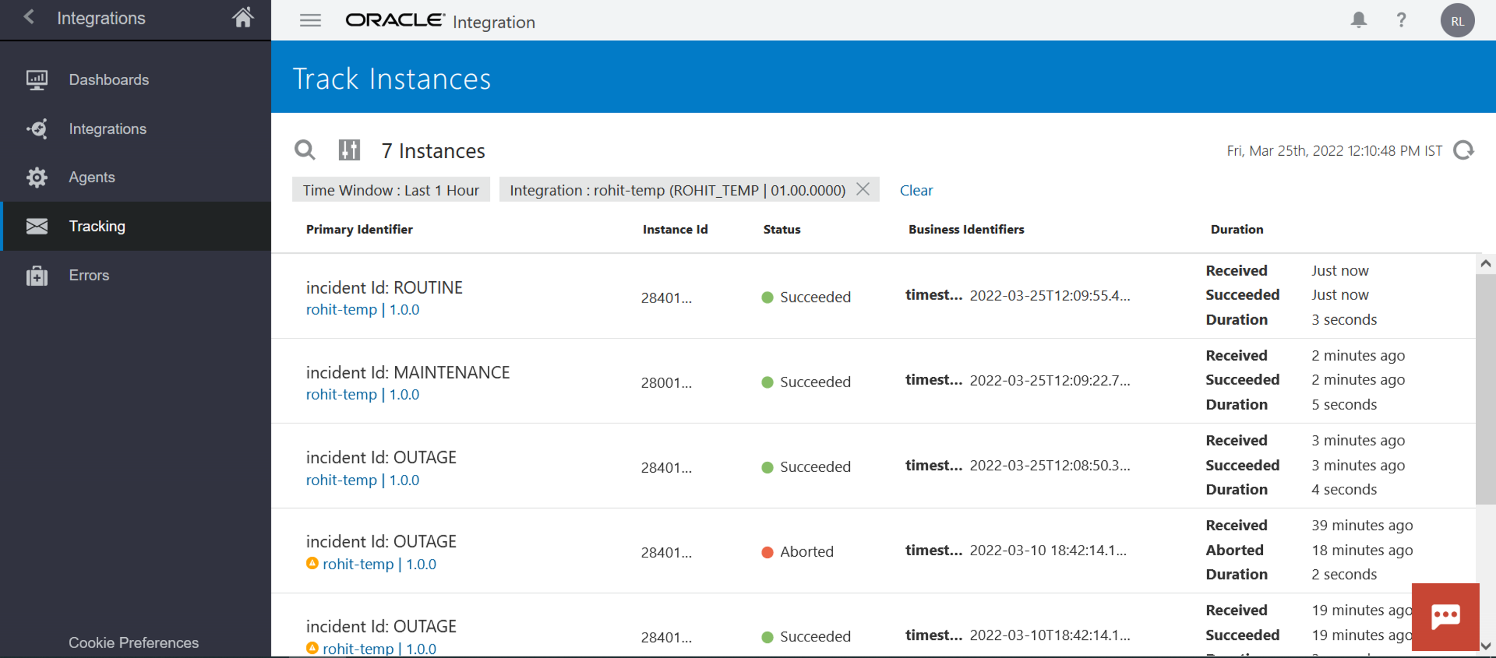
Step 7: Predicting the Events and triggering an Integration

Slide 21
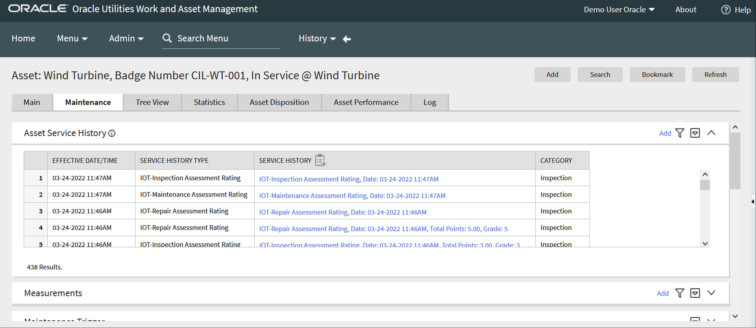
Step 7: Creating WAM Activity in IOT Work Order
17

Slide 22
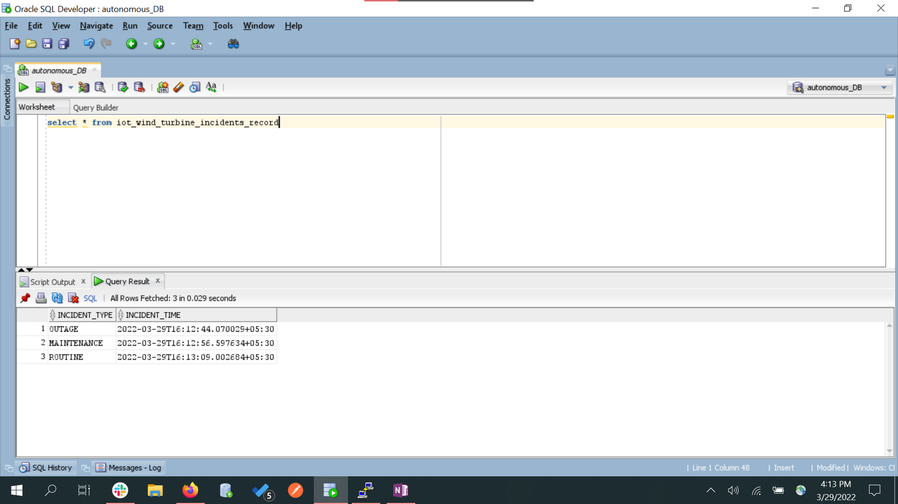
Step 8: Keeping track of all the occurrence of events in database

Slide 23
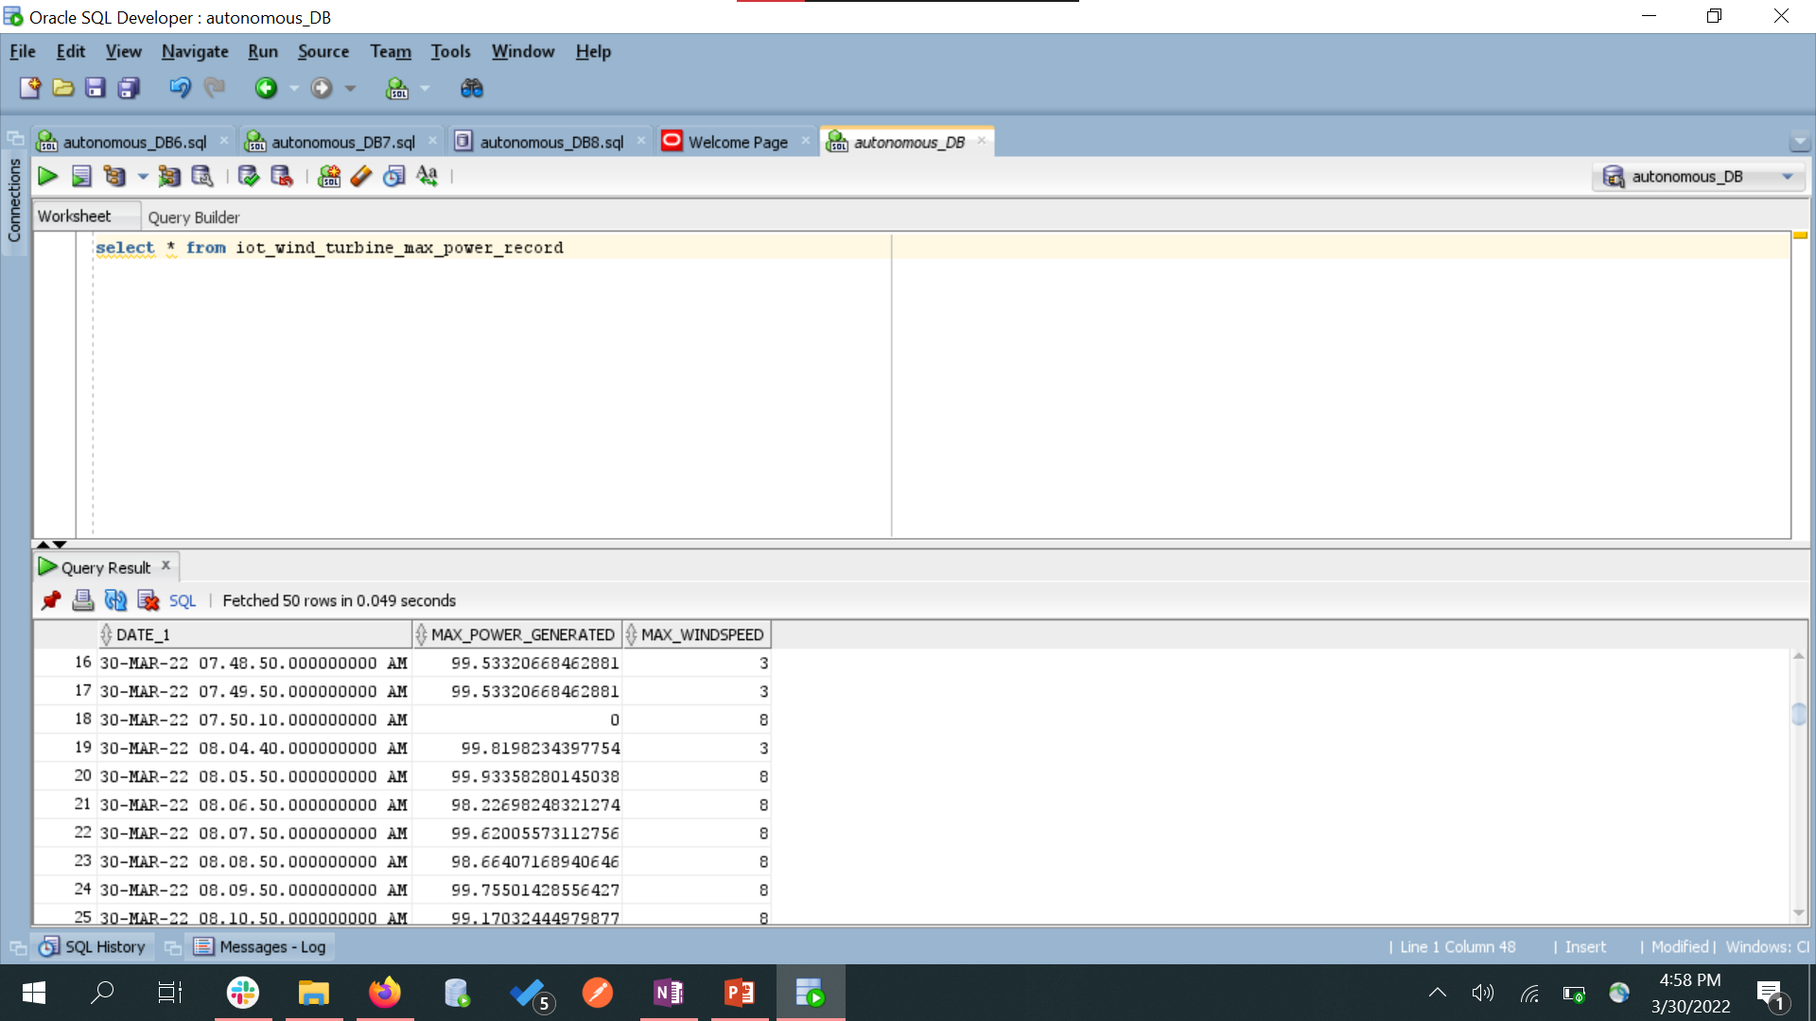
Step 9: Keeping track of max power output and max wind speed per day in the database

Slide 24
Demo

Slide 25
Future Scope
Detect more events with Machine Learning Models
Inclusion of OFSC
Working with real time data and challenges
Working with more devices at different locations (scalability)

Slide 26
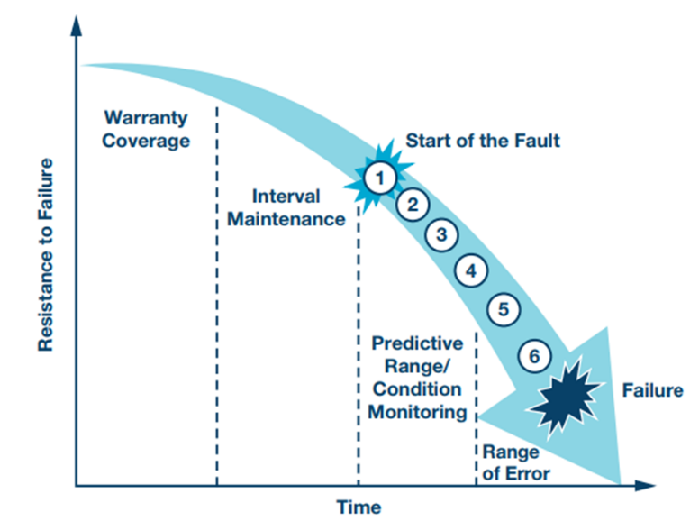
The 50 Word Blurb Executive Summary
26
Alerts generation for outages/maintenance/inspection by sensing the deviation from wind turbine attributes.
Based on the principle of predictive maintenance rather than preventive maintenance
Also provides some useful visualization.
For future reference filtered/final output is stored in database.
Notes:
In simpler words our solution will detect the events in advance based on some pre defined conditions this is called CM
It is the process of monitoring condition of machinery based on some parameters (such as vibration, hub rotational speed, temperature, etc) the changes in these params could indicate a developing fault.
This comes under predictive maintenance
Preventive maintenance (PM) we have regular and routine maintenance of asset in order to keep them running and prevent it from any costly unplanned downtime due to unexpected failures –
Where as the goal of condition based maintenance is to spot upcoming equipment failure so that maintenance can be proactively scheduled when it is needed – and not before. This is what separates predictive maintenance from preventive maintenance. .
This schedule is rigorously followed, regardless of how much life is left in the lubricants or parts.

Slide 27
References
https://kafka.apache.org/documentation/
https://docs.oracle.com/en/cloud/paas/iot-cloud/iotgs/use-oracle-iot-digital-twin-simulator1.html
https://docs.oracle.com/en/middleware/fusion-middleware/osa/19.1/osamp/getting-started-goldengate-stream-analytics-oci.html
https://docs.oracle.com/en/cloud/paas/integration-cloud/index.html

Slide 28


